Slide 1
Optimal yaw angle predictor for wind turbine
AIE-B Group 2
Anantha Krishna SK (CB.SC.U4AIE24102)
Sri Ram Krishna M (CB.SC.U4AIE24127)
T Devi Sri Soumith (CB.SC.U4AIE24155)
Yogesh JK (CB.SC.U4AIE24161)

Slide 2
oBJECTIVES
Ensure maximum power output by optimizing the turbine’s yaw angle.
Enhance the efficiency of renewable energy production.
Improve wind turbine performance by reducing energy losses due to improper yaw alignment.
Contribute to sustainable and cost-effective energy solutions.

Slide 3
Reference papers
Machine Learning-Based Approach to Wind Turbine Wake Prediction under Yawed Conditions
Authors: Mohan Kumar Gajendra, Ijaz Fazil Syed Ahmed Kabir, Sudhakar Vadivelu, E. Y. K. Ng
Year of publication: 2023
https://www.mdpi.com/2077-1312/11/11/2111
Maximum Power Point Tracking Control Method for the Small Wind Power Generation System Corresponding to Wind Speed Variation
Authors: Yuki Ando, Naoki Yamamura, Muneaki Ishida
Year of publication: 2020
https://ieeexplore.ieee.org/document/9291009

Slide 4
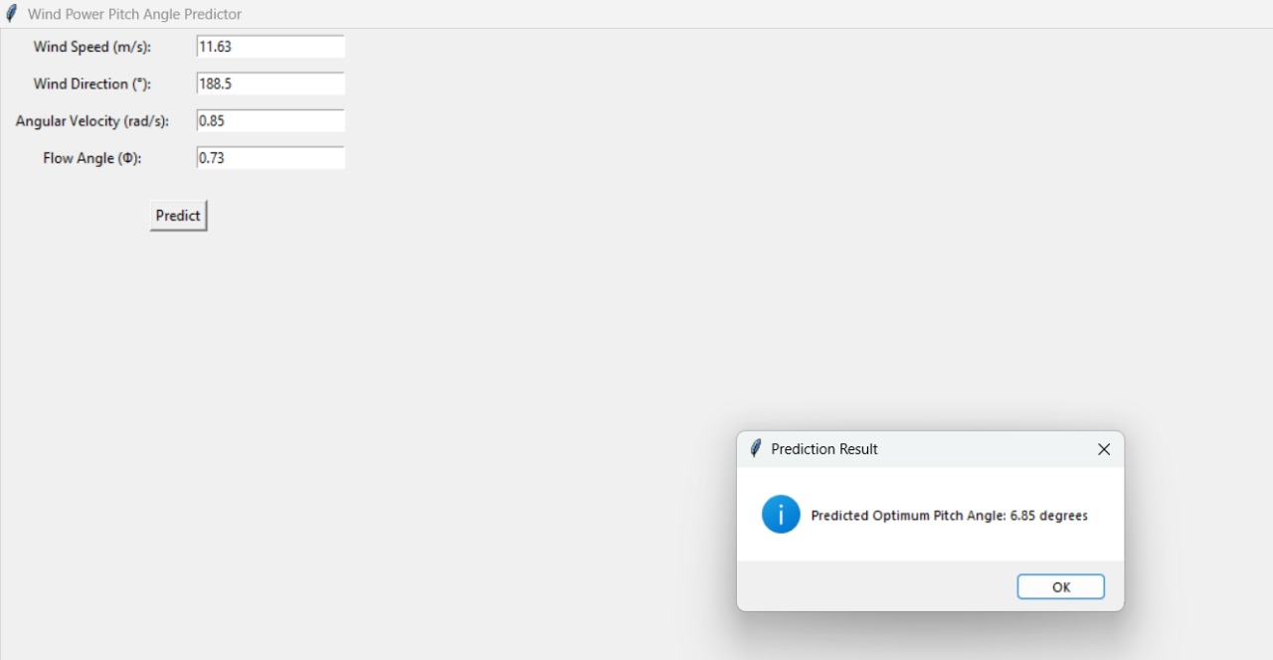
ML-Based Approach (Artificial Neural Network - ANN)
Uses ANN to predict the optimal yaw angle based on wind speed, wind direction, angular velocity, and flow angle.
Dataset is normalized using MinMaxScaler.
ANN consists of multiple layers with ReLU activation and dropout layers to prevent overfitting.
Model is trained using the Adam optimizer and Mean Squared Error (MSE) loss function.
Evaluation is performed using R² score and Mean Absolute Error (MAE).

Slide 5
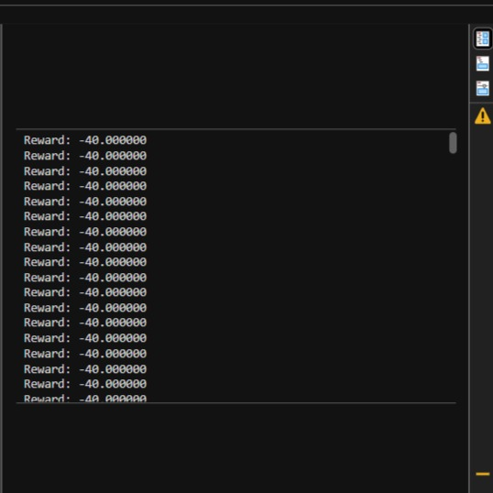
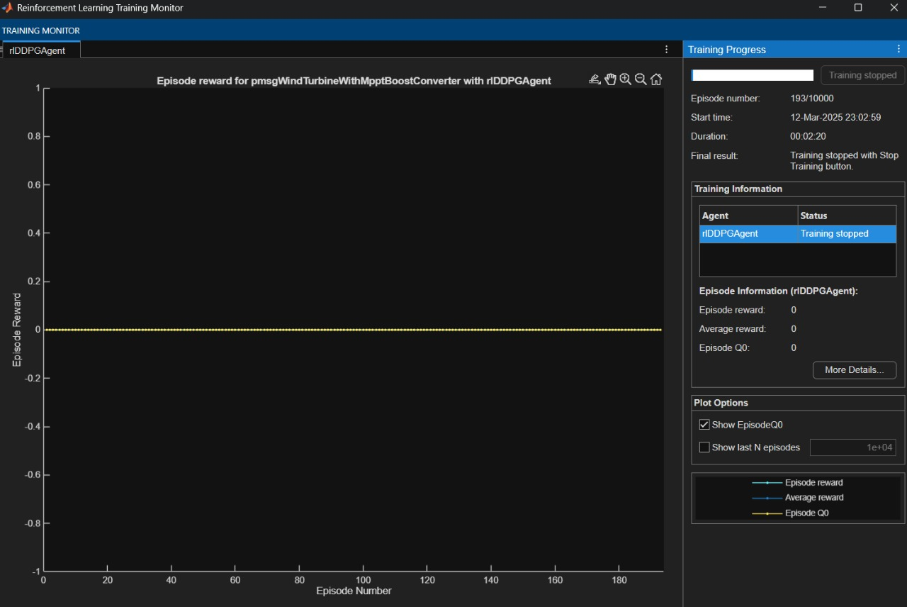
RL-Based Approach (Deep Reinforcement Learning - DDPG)
Actor-Critic architecture: Actor predicts optimal yaw angle, and Critic evaluates the decision.
Custom Simulink environment is created with wind speed, rotor speed, and generated power as variables.
Uses Experience Replay Buffer and exploration noise for better learning.
Training is performed for 10,000 episodes until an optimal policy is learned.

Slide 6
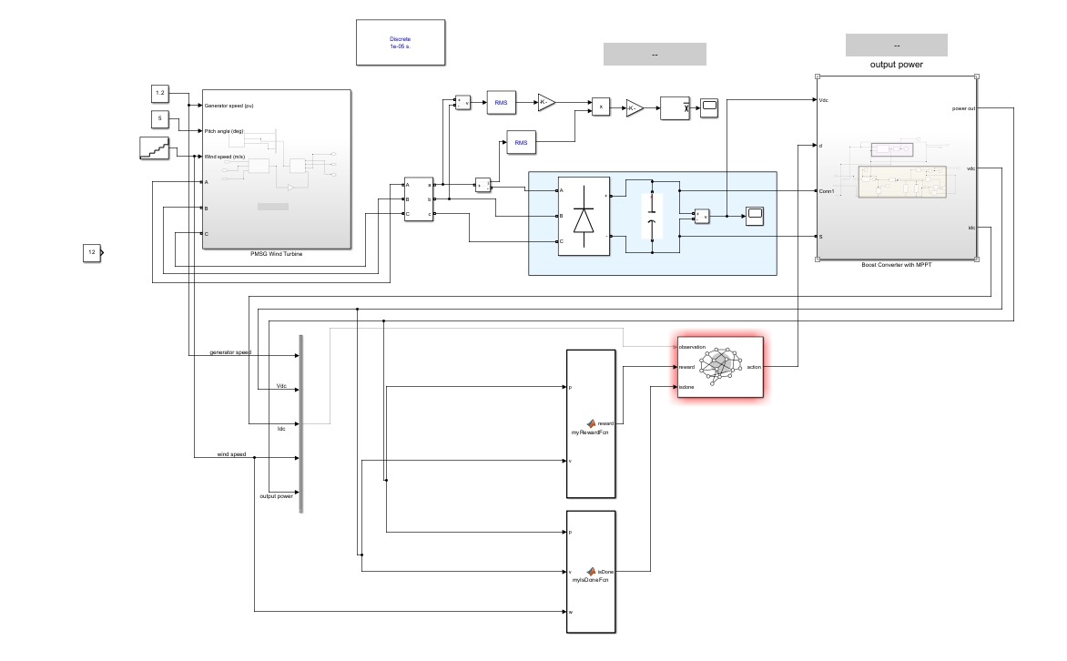
Simulink block

Slide 7
Concepts
1. Aerodynamics of Wind Turbines
Wind turbines operate on the principles of aerodynamics, where the flow of air over the blades generates lift and rotational motion. The key aerodynamic forces include:
Lift: Generated due to pressure differences, helping the blade rotate.
Drag: Opposes motion and reduces efficiency.
Angle of Attack (AoA): The angle between the relative wind direction and the blade profile.
2. Wind Power Equation
The power extracted from the wind is given by the equation:
P = 0.5 × ρ × A × V³ × Cp
ρ: Air density (kg/m³)
A: Swept area of the rotor (m²)
V: Wind speed (m/s)
Cp: Power coefficient, representing turbine efficiency

Slide 8
3. Yaw Angle Optimization
The yaw angle determines the alignment of the turbine with the wind direction. Optimizing the yaw angle maximizes power output by ensuring the best angle of attack and minimizing wake effects.
4. Machine Learning in Prediction
Using Artificial Neural Networks (ANN), the model learns patterns in wind behavior and predicts the optimal yaw angle based on:
Wind Speed
Wind Direction
Angular Velocity
Flow Angle
This enhances turbine efficiency by dynamically adjusting the yaw angle.

Slide 9
5. Reinforcement Learning (RL) Approach
RL trains an agent to interact with the environment and maximize rewards. In this case, the RL agent:
Receives observations: wind speed, rotor speed, power output.
Performs actions: adjusting yaw angle.
Optimizes energy generation over multiple episodes.

Slide 10
Thank You

